Slide 1


Hackathon Project Final Presentation
January 24th, 2025
Fehmi Özbayrak, Ibrahim Gomaa, Zülküf Azizoglu, Paawan Desai, Yevgeniy Samarkin
PGE & ECE

Slide 2
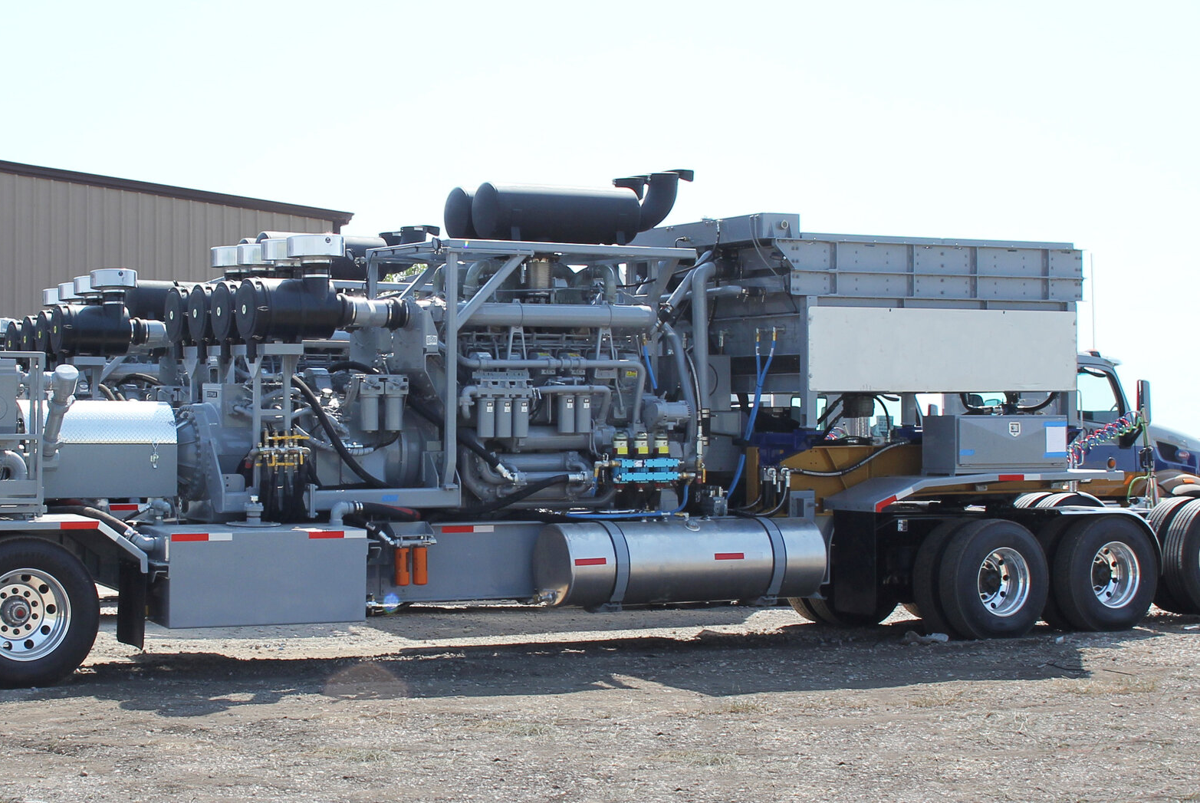
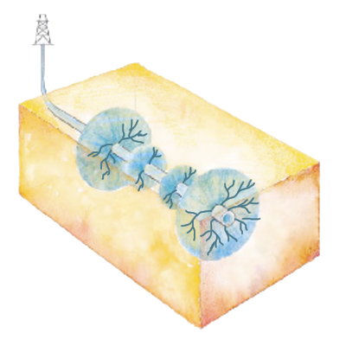


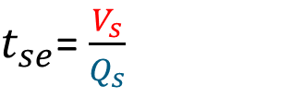
Executive summary / data at first glance
1. What is the problem?
- Prediction of fuel required to complete a fracking operation
2. What did your team do to address the problem?
- Clean the data / impute the missing data / test different models
3. What did your team learn?
- Domain expertise & data preprocessing are key steps
4. What does your team recommend going forward?
- Eat more tacos & do machine learning
Temperature
Fleet type
$t_{se}$= $\frac{V_{s}}{Q_{s}}$
Proppant type
# Stages
Formation
# Clusters

Slide 3
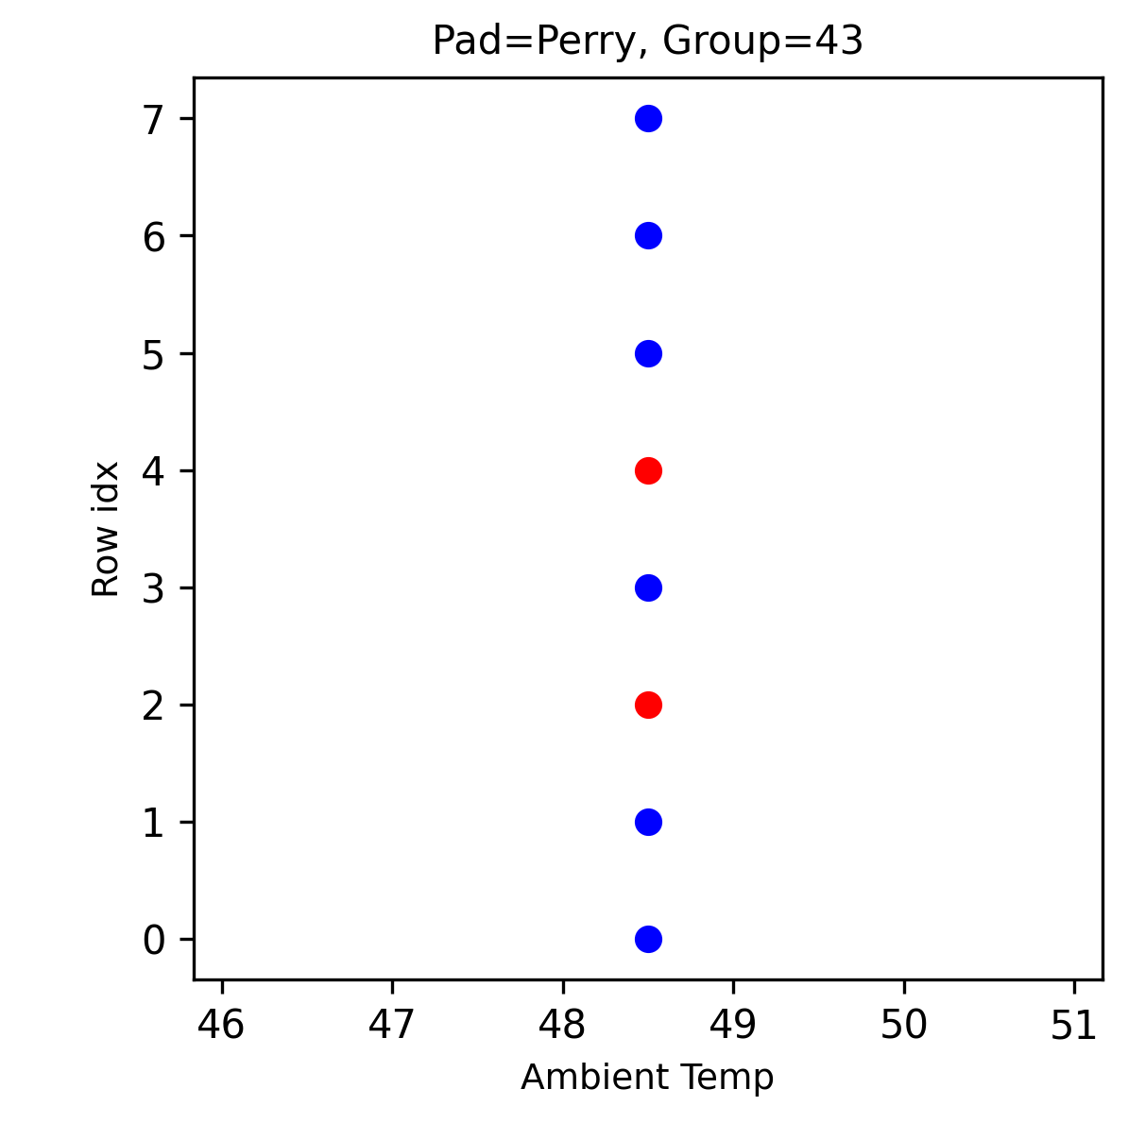
Feature Analysis and Input Data
Available Data
Missing Data
Check the consequent entries and unique identifiers (Well Name + Field).

Slide 4
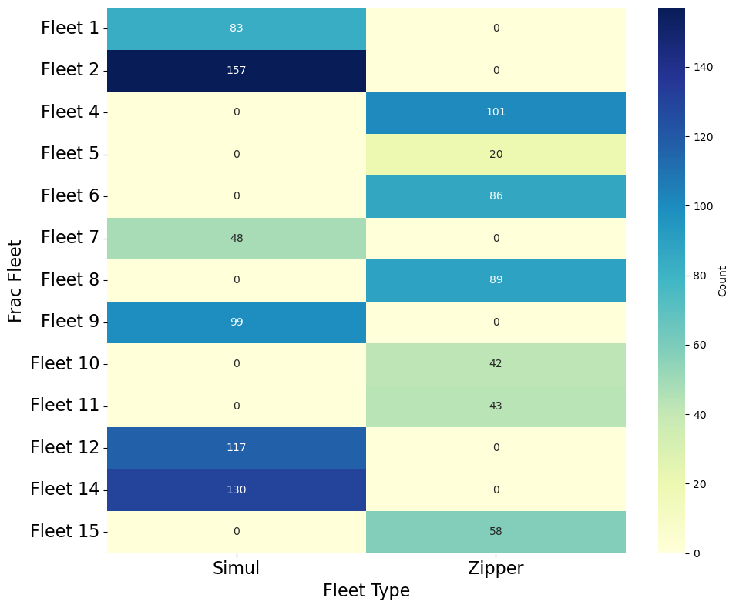
Feature Analysis and Input Data
Fleets are specialized in one type only
Discard Fleet Type

Slide 5
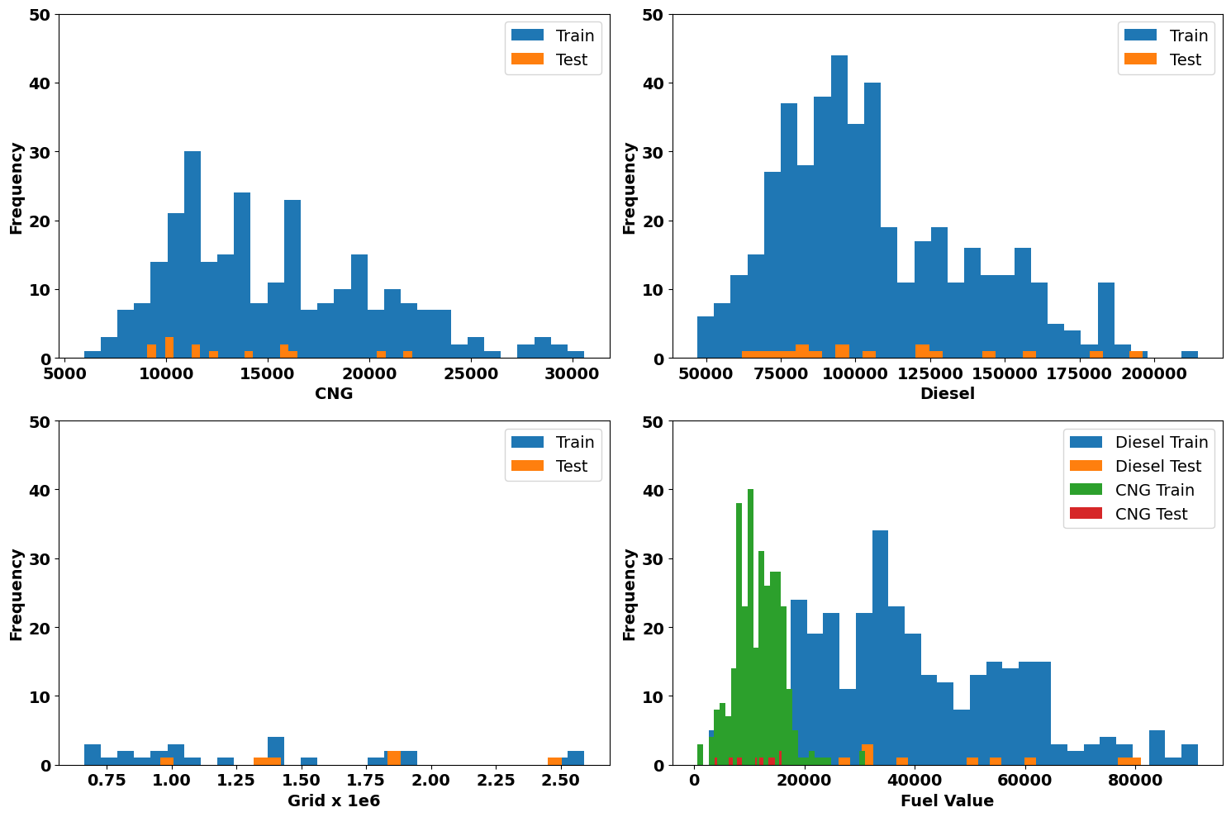
CNG
Diesel
Grid
DGB

Slide 6
Feature Encoding
What is Encoding?
Converting categorical features into numerical formats for machine learning algorithms.
Common Techniques
CatBoost Encoding
One-Hot Encoding
Feature | One-Hot Encoding | CatBoost Encoding
Feature Expansion | Increases feature count significantly. | No feature expansion.
Memory Usage | High for datasets with many categories. | Low memory overhead.
Ease of Use | Easy to implement with general-purpose libraries. | Requires CatBoost-specific implementation.
Model Performance | Can degrade performance in high-dimensional data. | Optimized for categorical data handling.
Compatibility | Works with all ML models. | Works only with CatBoost.
12 input features vs 1082 input features

Slide 7
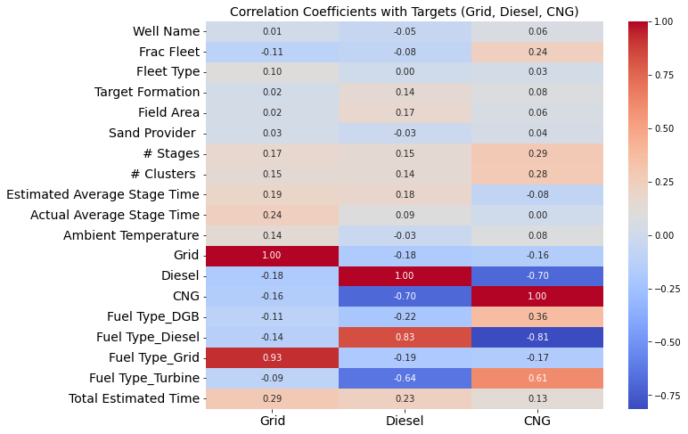
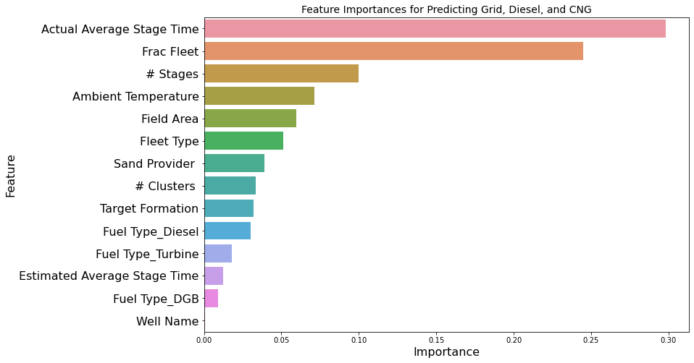
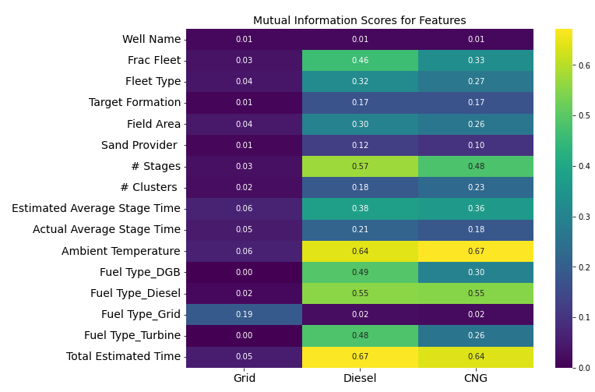
Feature Ranking
Top Selected Features
# Stages x Estimated average stage time
Frac Fleet & Target Formation
Ambient Temperature
Fuel Type

Slide 8
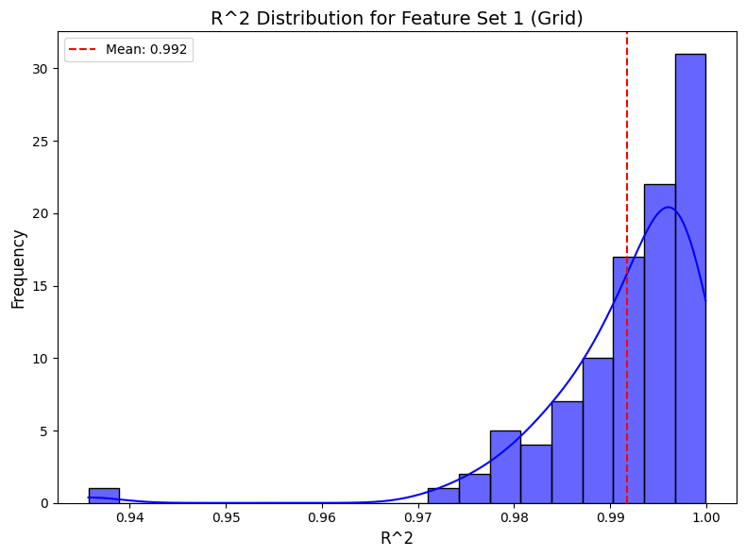
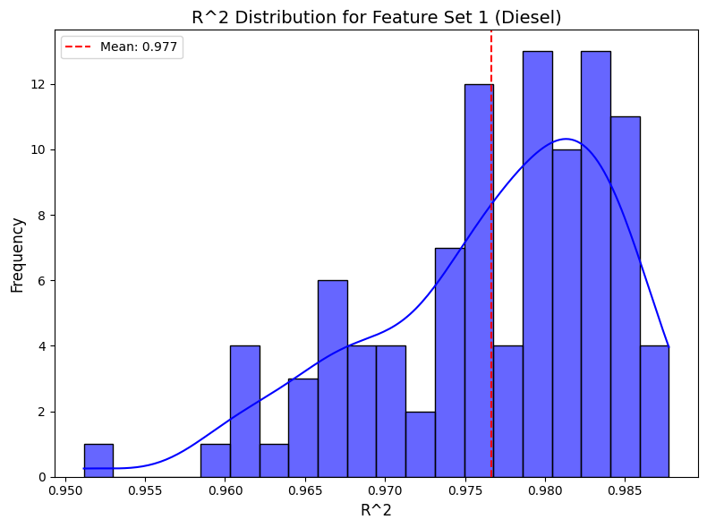
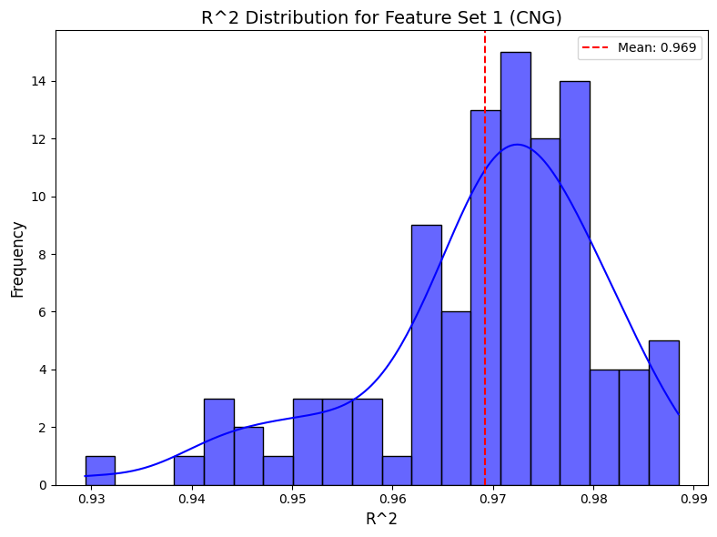
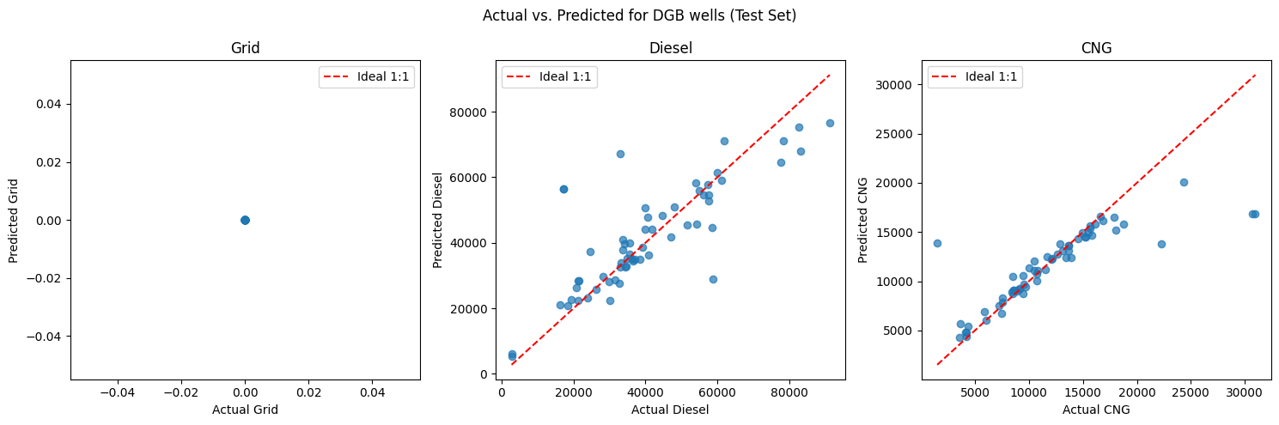
Model Building
Training & Validation
Features
Numerical: Estimated Total Time, Ambient Temperature
Categorical: Fuel Type, Frac Fleet, Target Formation
Model: Random Forest
Accuracy (Average of 100 runs)
R²: 0.9918 (Grid) | 0.9766 (Diesel) | 0.9692 (CNG)

Slide 9
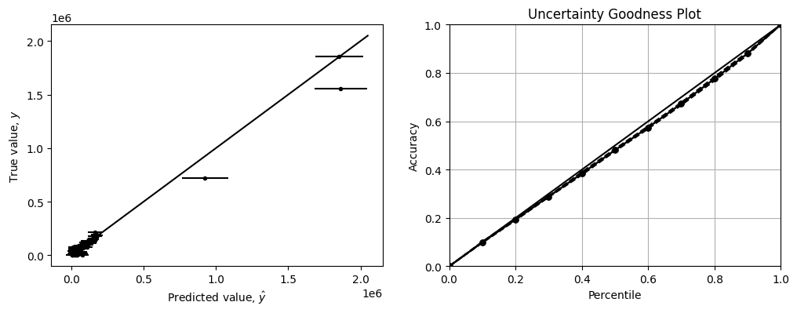
Model Building
Uncertainty Modeling
Goodness Plot (100 runs): 0.90 (Avg)
Scaling: 1.08: 0.90 → 0.98

Slide 10
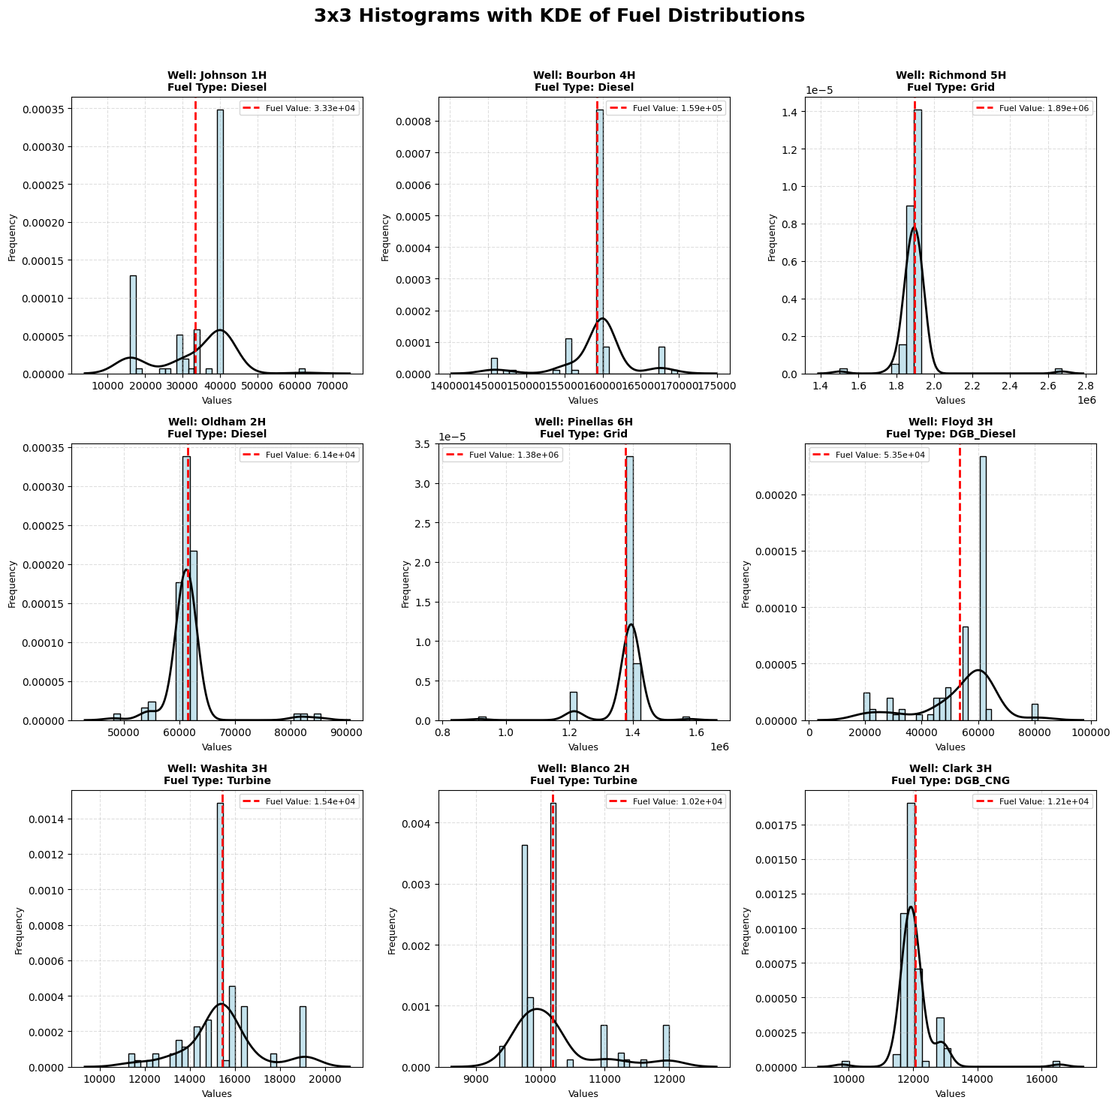
Prediction
We apply same preprocessing & feature engineering to testing data, then we predict!

Slide 11





Zülküf
Fehmi
Yevgeniy
Paawan
Ibrahim

